Slide 1
Onboarding Checklist Completion Report

Slide 2
Objective
Identify whether certain steps on the Onboarding Checklist are affecting checklist completion

Slide 3
Report Specifications
All Onboarding checklists assigned from September to December 2021
Lists all steps of checklists, their completion status, and whether or not they are required or optional
Also lists location data of the employee the checklist has been assigned to

Slide 4
Onboarding Checklist Steps
Required
Retiree Acknowledgement Form
Direct Deposit
TCG Administrators 457(b)
Worker's Compensation Coverage
Alief ISD New Teacher Survey
Benefit Signature Sheet
Outside Employment Notification Form
21-22 Payroll Calendar
Federal Ethnicity and Race Identification
Social Security Statement
Employee Information Sheet
Camp Alief Brochure - New Hire Teachers
New Hire Checklist
Onboarding Checklist Completion
How to use employee records

Slide 5
Onboarding Checklist Steps
Optional
Review and sign-off on employee guide
Employment Questionnaire for TRS
Public Access to Employee Records Form
I-9 Form
W-4 Form
I-9 Supporting Documents
Workers' Compensation 504 Medical Care Program Form
TRS - Retirement Status Page

Slide 6
Checklist Completion
Checklist Complete? | Yes | No | TOTAL | Percent Complete
 | 15 | 319 | 334 | 4.49%

Slide 7
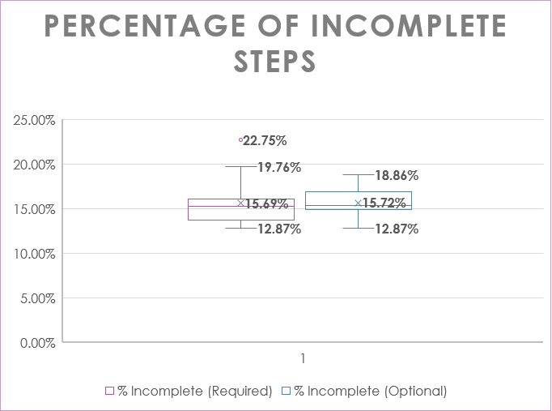
Interpretation
Outlier: 'Onboarding Checklist Completion' form is not being complete
Similar means and similar range

Slide 8
Statistical Analysis
t-Test: Two-Sample Assuming Unequal Variances
 | Incomplete (Required) | Incomplete (Optional)
Mean | 0.156886228 | 0.157185629
Variance | 0.000669491 | 0.000315024
Observations | 15 | 8
Hypothesized Mean Difference | 0
df | 19
t Stat | -0.032665256
P(T<=t) one-tail | 0.487141122
t Critical one-tail | 1.729132812
P(T<=t) two-tail | 0.974282244
t Critical two-tail | 2.093024054
Interpretation
There is no significant difference between completion of voluntary steps and required steps

Slide 9
Conclusion
Investigation is needed as to why ‘Onboarding Checklist Completion’ is not being completed.
Because this is the final step in the workflow, it is preventing the checklist from being completed. (Only 4.49% of checklists have been completed)

